Slide 1
Creating a Respectful Workplace Culture
Notes:
Tell: Hello, and welcome to Creating a Respectful Workplace Culture training.

Slide 2
Respect Can Mean Different Things
Respect is a commonly used term that we often read about in news articles, use in our employee handbooks, and even hear in famous songs.
Articles
Employee Handbook
Famous Song
Notes:
TELL: Respect can mean many different things. Respect is a commonly used term that we often read in articles online, use in our very own employee handbooks, and even hear in famous songs, like R-E-S-P-E-C-T.

Slide 3
RESPECT
OWED AND EARNED
Notes:
TELL: Let’s talk about the two types of respect.

Slide 4
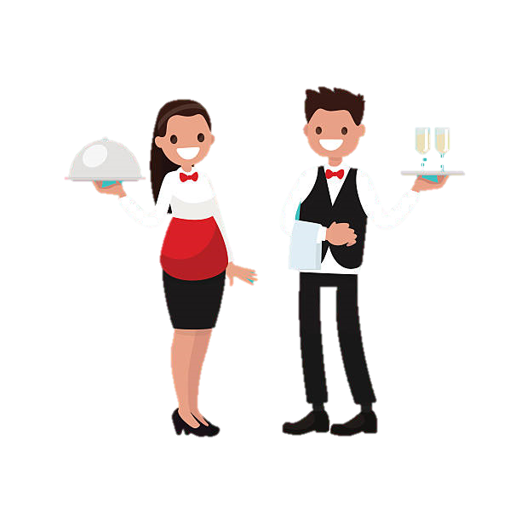
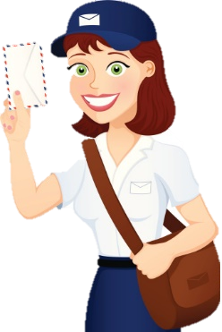
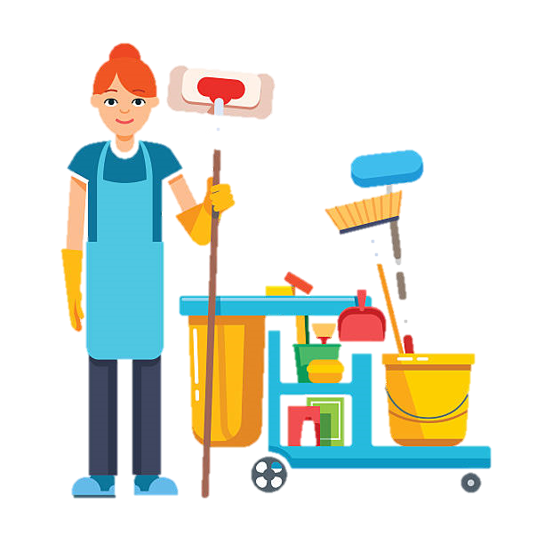
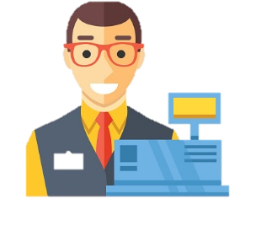
What are some other examples of people you know whom you give or receive respect from?
Mail Carrier
Custodians
Type 1: Owed Respect
Store Cashier
Wait Staff
Owed respect is the due regard for the feelings, wishes, rights, or traditions of others.
Notes:
TELL: The second type of respect we’ll be talking about is Owed Respect. Owed respect is the basic respect and consideration all people deserve. We owe it to each other to treat one another with decency, civility, and professionalism.
ASK: What are some other examples of people you know whom you give or receive respect from?
INSTRUCTOR: Solicit feedback from audience.
CLICK
TELL: We owe basic respect to the store cashier, your co-worker, a stranger, basically every human being.

Slide 5
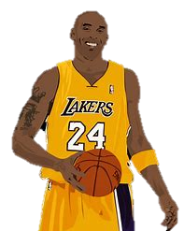
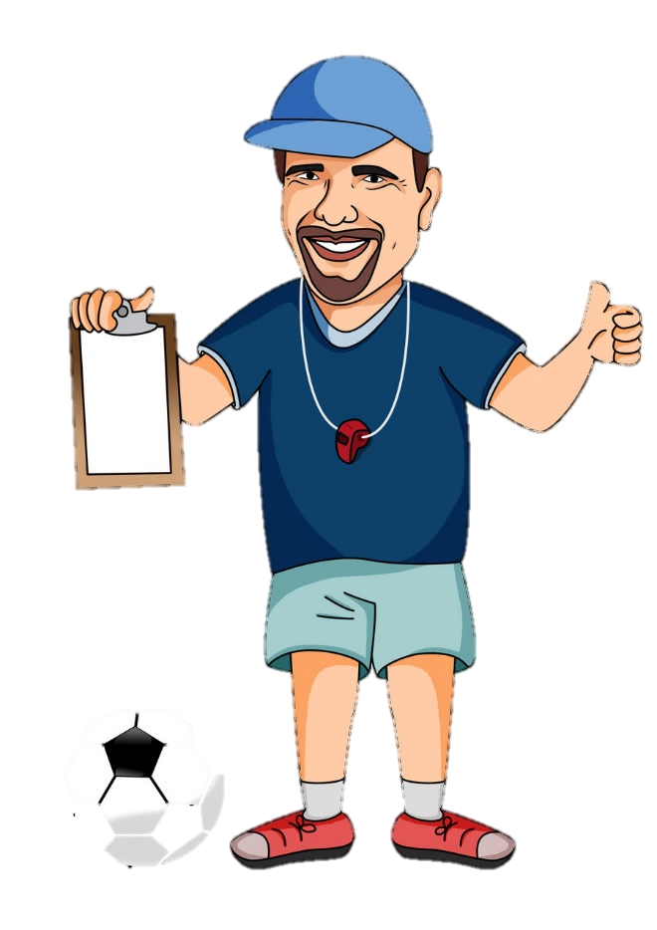
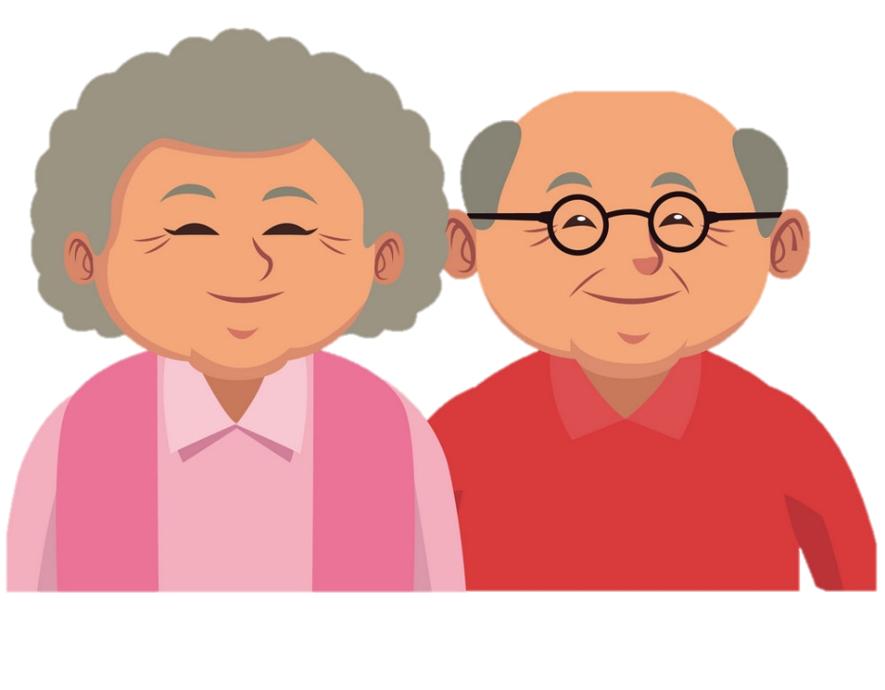
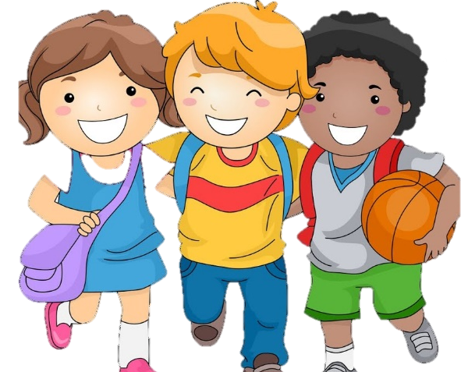
What are some other examples of people you know who have earned your respect?
Grandparents
Friends
Type 2: Earned Respect
Earned respect comes from a feeling of admiration for an individual for their abilities, qualities, or achievements.
Mentor/Coach
Celebrities
Notes:
TELL: The first type of respect we’ll be talking about is Earned Respect. Earned respect comes from a feeling of admiration for an individual for their abilities, qualities, or achievements. Here are some well-known respected figures from history: Albert Einstein, Cesar Chavez, Rosa Parks, Mother Theresa, and Martin Luther King Jr.
ASK: What are some other examples of people you know who have earned your respect?
INSTRUCTOR: Solicit feedback from audience.
CLICK
TELL: It could be a good friend, your co-worker, a family member, a manager, a mentor, or a coach.

Slide 6
Disrespectful vs Unprofessional
Please look at the 10 situations on the Disrespectful vs Unprofessional Worksheet in your packet.
Circle which word best describes each scenario: Disrespectful, Unprofessional, or Both.
Take 3 minutes to complete, and then we will discuss.
Notes:
ASK: What does a disrespectful workplace look like?
INSTRUCTOR: Solicit responses from audience
CLICK
TELL: A disrespectful workplace could look like a place where people are inconsiderate of others around them by talking too loudly and in a rude attitude or tone. They could also be playing personal music too loud that it distracts others, is constantly complaining and bringing others down with their negativity. Is non-inclusive of others and causes people to feel like an outsider. Wastes other people’s time but being late to meetings. Judging or criticizing other because they are different. Or never taking responsibility and passing blame to others. Giving certain people special treatment, or leaving a mess of shared spaces like the breakroom and restrooms. Telling offensive and inappropriate jokes. Gossiping about other, bullying, and even taking credit for other people’s work. Here are just some examples of what a disrespectful workplace could look like?

Slide 7
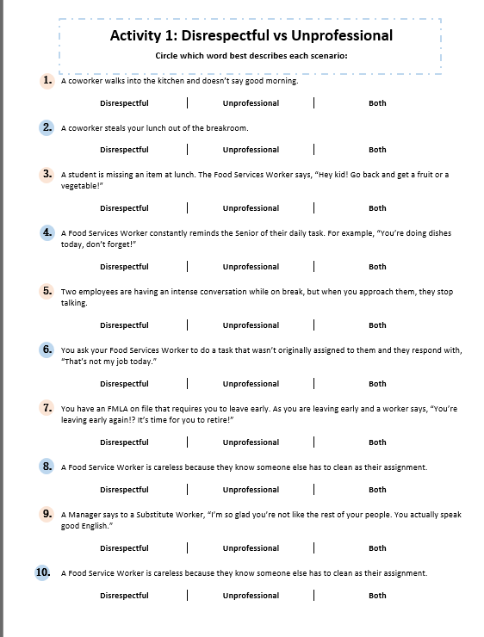
3 Minutes
Activity 1 - Let’s Begin!
Circle which word best describes each scenario: Disrespectful, Unprofessional, or Both.
Notes:
ASK: What does a disrespectful workplace look like?
INSTRUCTOR: Solicit responses from audience
CLICK
TELL: A disrespectful workplace could look like a place where people are inconsiderate of others around them by talking too loudly and in a rude attitude or tone. They could also be playing personal music too loud that it distracts others, is constantly complaining and bringing others down with their negativity. Is non-inclusive of others and causes people to feel like an outsider. Wastes other people’s time but being late to meetings. Judging or criticizing other because they are different. Or never taking responsibility and passing blame to others. Giving certain people special treatment, or leaving a mess of shared spaces like the breakroom and restrooms. Telling offensive and inappropriate jokes. Gossiping about other, bullying, and even taking credit for other people’s work. Here are just some examples of what a disrespectful workplace could look like?

Slide 8
A coworker walks into the kitchen and doesn’t say good morning.
This is unprofessional because it can be seen as poor workplace etiquette, however it is not disrespectful because it is not intended to insult or slight their coworkers.
1
Disrespectful
Unprofessional
Both
Notes:
ASK: What does a disrespectful workplace look like?
INSTRUCTOR: Solicit responses from audience
CLICK
TELL: A disrespectful workplace could look like a place where people are inconsiderate of others around them by talking too loudly and in a rude attitude or tone. They could also be playing personal music too loud that it distracts others, is constantly complaining and bringing others down with their negativity. Is non-inclusive of others and causes people to feel like an outsider. Wastes other people’s time but being late to meetings. Judging or criticizing other because they are different. Or never taking responsibility and passing blame to others. Giving certain people special treatment, or leaving a mess of shared spaces like the breakroom and restrooms. Telling offensive and inappropriate jokes. Gossiping about other, bullying, and even taking credit for other people’s work. Here are just some examples of what a disrespectful workplace could look like?

Slide 9
A coworker steals your lunch out of the breakroom.
This is both disrespectful and unprofessional because it can be seen as poor workplace etiquette, as well as a complete disregard for their coworkers personal belongings.
2
Disrespectful
Unprofessional
Both
Notes:
ASK: What does a disrespectful workplace look like?
INSTRUCTOR: Solicit responses from audience
CLICK
TELL: A disrespectful workplace could look like a place where people are inconsiderate of others around them by talking too loudly and in a rude attitude or tone. They could also be playing personal music too loud that it distracts others, is constantly complaining and bringing others down with their negativity. Is non-inclusive of others and causes people to feel like an outsider. Wastes other people’s time but being late to meetings. Judging or criticizing other because they are different. Or never taking responsibility and passing blame to others. Giving certain people special treatment, or leaving a mess of shared spaces like the breakroom and restrooms. Telling offensive and inappropriate jokes. Gossiping about other, bullying, and even taking credit for other people’s work. Here are just some examples of what a disrespectful workplace could look like?

Slide 10
This is unprofessional because the use of the phrase “Hey kid,” is below the standards expected of a Food Service Worker. It is not disrespectful because it is not intended to insult the child.
3
A student is missing an item at lunch. The Food Service Worker says, “Hey kid! Go back and get a fruit or a vegetable!”
Disrespectful
Unprofessional
Both
Notes:
ASK: What does a disrespectful workplace look like?
INSTRUCTOR: Solicit responses from audience
CLICK
TELL: A disrespectful workplace could look like a place where people are inconsiderate of others around them by talking too loudly and in a rude attitude or tone. They could also be playing personal music too loud that it distracts others, is constantly complaining and bringing others down with their negativity. Is non-inclusive of others and causes people to feel like an outsider. Wastes other people’s time but being late to meetings. Judging or criticizing other because they are different. Or never taking responsibility and passing blame to others. Giving certain people special treatment, or leaving a mess of shared spaces like the breakroom and restrooms. Telling offensive and inappropriate jokes. Gossiping about other, bullying, and even taking credit for other people’s work. Here are just some examples of what a disrespectful workplace could look like?

Slide 11
This is unprofessional because supervision is not in the job description of the Food Service Worker, however they may not be intending to undermine their Senior’s authority.
4
A Food Service Worker constantly reminds the Senior of their daily task.
For example, “You’re doing dishes today, don’t forget!”
Disrespectful
Unprofessional
Both
Notes:
ASK: What does a disrespectful workplace look like?
INSTRUCTOR: Solicit responses from audience
CLICK
TELL: A disrespectful workplace could look like a place where people are inconsiderate of others around them by talking too loudly and in a rude attitude or tone. They could also be playing personal music too loud that it distracts others, is constantly complaining and bringing others down with their negativity. Is non-inclusive of others and causes people to feel like an outsider. Wastes other people’s time but being late to meetings. Judging or criticizing other because they are different. Or never taking responsibility and passing blame to others. Giving certain people special treatment, or leaving a mess of shared spaces like the breakroom and restrooms. Telling offensive and inappropriate jokes. Gossiping about other, bullying, and even taking credit for other people’s work. Here are just some examples of what a disrespectful workplace could look like?

Slide 12
This is neither unprofessional nor disrespectful because employees are allowed to have private conversations on their break. Assume their conversation is not about you.
5
Two employees are having an intense conversation while on break, but when you approach them, they stop talking.
Trick Question!
Neither
Disrespectful
Unprofessional
Both
Notes:
ASK: What does a disrespectful workplace look like?
INSTRUCTOR: Solicit responses from audience
CLICK
TELL: A disrespectful workplace could look like a place where people are inconsiderate of others around them by talking too loudly and in a rude attitude or tone. They could also be playing personal music too loud that it distracts others, is constantly complaining and bringing others down with their negativity. Is non-inclusive of others and causes people to feel like an outsider. Wastes other people’s time but being late to meetings. Judging or criticizing other because they are different. Or never taking responsibility and passing blame to others. Giving certain people special treatment, or leaving a mess of shared spaces like the breakroom and restrooms. Telling offensive and inappropriate jokes. Gossiping about other, bullying, and even taking credit for other people’s work. Here are just some examples of what a disrespectful workplace could look like?

Slide 13
However it is not disrespectful because it is not intended to insult or undermine the authority of the manager. Objections aren’t inherently disrespectful.
This is unprofessional because it is improper to address a superior this way.
6
You ask your Food Service Worker to do a task that wasn’t originally assigned to them and they respond with,
“That’s not my job today.”
Disrespectful
Unprofessional
Both
Notes:
ASK: What does a disrespectful workplace look like?
INSTRUCTOR: Solicit responses from audience
CLICK
TELL: A disrespectful workplace could look like a place where people are inconsiderate of others around them by talking too loudly and in a rude attitude or tone. They could also be playing personal music too loud that it distracts others, is constantly complaining and bringing others down with their negativity. Is non-inclusive of others and causes people to feel like an outsider. Wastes other people’s time but being late to meetings. Judging or criticizing other because they are different. Or never taking responsibility and passing blame to others. Giving certain people special treatment, or leaving a mess of shared spaces like the breakroom and restrooms. Telling offensive and inappropriate jokes. Gossiping about other, bullying, and even taking credit for other people’s work. Here are just some examples of what a disrespectful workplace could look like?

Slide 14
It is unprofessional because supervising is not in the job description of a worker. It’s disrespectful because the comment about retiring clearly shows the worker has a bias against your age.
7
You have an FMLA on file that requires you to leave early. As you are leaving early a worker says, “You’re leaving early again!? It’s time for you to retire!”
Disrespectful
Unprofessional
Both
Notes:
ASK: What does a disrespectful workplace look like?
INSTRUCTOR: Solicit responses from audience
CLICK
TELL: A disrespectful workplace could look like a place where people are inconsiderate of others around them by talking too loudly and in a rude attitude or tone. They could also be playing personal music too loud that it distracts others, is constantly complaining and bringing others down with their negativity. Is non-inclusive of others and causes people to feel like an outsider. Wastes other people’s time but being late to meetings. Judging or criticizing other because they are different. Or never taking responsibility and passing blame to others. Giving certain people special treatment, or leaving a mess of shared spaces like the breakroom and restrooms. Telling offensive and inappropriate jokes. Gossiping about other, bullying, and even taking credit for other people’s work. Here are just some examples of what a disrespectful workplace could look like?

Slide 15
However, if the worker only does this behavior on days when a certain coworker has to clean that area, then it would be both, because they are targeting one person.
This is unprofessional because it is in the job description of a Food Services Worker to keep their workspace clean. It is not disrespectful because it is not directed at a specific coworker.
8
A Food Service Worker is careless with their work area because they know someone else has to clean as their assignment.
Disrespectful
Unprofessional
Both
Notes:
ASK: What does a disrespectful workplace look like?
INSTRUCTOR: Solicit responses from audience
CLICK
TELL: A disrespectful workplace could look like a place where people are inconsiderate of others around them by talking too loudly and in a rude attitude or tone. They could also be playing personal music too loud that it distracts others, is constantly complaining and bringing others down with their negativity. Is non-inclusive of others and causes people to feel like an outsider. Wastes other people’s time but being late to meetings. Judging or criticizing other because they are different. Or never taking responsibility and passing blame to others. Giving certain people special treatment, or leaving a mess of shared spaces like the breakroom and restrooms. Telling offensive and inappropriate jokes. Gossiping about other, bullying, and even taking credit for other people’s work. Here are just some examples of what a disrespectful workplace could look like?

Slide 16
This statement might not be ill-intended, but it is still disrespectful because the manager is comparing people from a certain ethnic/national/race group.
This shows a bias held by the manager, whether consciously or unconsciously.
This is unprofessional because it is not in the job description of a manager to grade a workers levels of English proficiency.
9
A Manager says to a Substitute Worker, “I’m so glad you’re not like the rest of your people. You actually speak good English.”
Disrespectful
Unprofessional
Both
Notes:
ASK: What does a disrespectful workplace look like?
INSTRUCTOR: Solicit responses from audience
CLICK
TELL: A disrespectful workplace could look like a place where people are inconsiderate of others around them by talking too loudly and in a rude attitude or tone. They could also be playing personal music too loud that it distracts others, is constantly complaining and bringing others down with their negativity. Is non-inclusive of others and causes people to feel like an outsider. Wastes other people’s time but being late to meetings. Judging or criticizing other because they are different. Or never taking responsibility and passing blame to others. Giving certain people special treatment, or leaving a mess of shared spaces like the breakroom and restrooms. Telling offensive and inappropriate jokes. Gossiping about other, bullying, and even taking credit for other people’s work. Here are just some examples of what a disrespectful workplace could look like?

Slide 17
It is disrespectful because the worker is intending to cause harm to the reputations of their coworkers.
This is unprofessional because giving performance reviews is not in the job description of a Food Service Worker
10
A Food Service Worker gossips around the school that all their coworkers are lazy.
Disrespectful
Unprofessional
Both
Notes:
ASK: What does a disrespectful workplace look like?
INSTRUCTOR: Solicit responses from audience
CLICK
TELL: A disrespectful workplace could look like a place where people are inconsiderate of others around them by talking too loudly and in a rude attitude or tone. They could also be playing personal music too loud that it distracts others, is constantly complaining and bringing others down with their negativity. Is non-inclusive of others and causes people to feel like an outsider. Wastes other people’s time but being late to meetings. Judging or criticizing other because they are different. Or never taking responsibility and passing blame to others. Giving certain people special treatment, or leaving a mess of shared spaces like the breakroom and restrooms. Telling offensive and inappropriate jokes. Gossiping about other, bullying, and even taking credit for other people’s work. Here are just some examples of what a disrespectful workplace could look like?

Slide 18
Disrespectful vs Unprofessional
What people take as disrespect varies from person to person, so let’s look at the definitions.
Disrespect: show a lack of respect for; insult
Unprofessional: below or contrary to the standards expected in a profession
Notes:
ASK: What does a disrespectful workplace look like?
INSTRUCTOR: Solicit responses from audience
CLICK
TELL: A disrespectful workplace could look like a place where people are inconsiderate of others around them by talking too loudly and in a rude attitude or tone. They could also be playing personal music too loud that it distracts others, is constantly complaining and bringing others down with their negativity. Is non-inclusive of others and causes people to feel like an outsider. Wastes other people’s time but being late to meetings. Judging or criticizing other because they are different. Or never taking responsibility and passing blame to others. Giving certain people special treatment, or leaving a mess of shared spaces like the breakroom and restrooms. Telling offensive and inappropriate jokes. Gossiping about other, bullying, and even taking credit for other people’s work. Here are just some examples of what a disrespectful workplace could look like?

Slide 19
CONFLICT
IN THE KITCHEN
Notes:
TRANSITION SLIDE ONLY

Slide 20
Close Quarters
When working in a kitchen, conflict will arise because:
Tight Working Spaces
Same Schedule Every Week
Breaks At The Same Time
Many Different Personalities
So how do you deal with it?
Notes:
TELL: When a group of people work together day after day, conflict is inevitable, but how you react to conflict is your choice.
CLICK
TELL: When you find yourself in a heated conflict, first you want take a moment to cool off and gather your thoughts. Do not ignore the situation or it will blow up when you least expect it. Talk it over calmly, be sure to watch your tone and words used. Communication is a two-way street, it consists of both talking and listening. It is important to listen carefully and attentively to what the other person has to say. And lastly, it is important to remember that it is completely alright to agree to disagree peacefully.

Slide 21
Dealing With Conflict
Conflict maybe unavoidable, but how you react to conflict is your choice.
Cool Off & Gather Your Thoughts
Talk It Over, Watch Your Tone & Words Used
Listen Carefully & Attentively
Agree To Disagree
Know When To Seek Guidance
Notes:
TELL: When a group of people work together day after day, conflict is inevitable, but how you react to conflict is your choice.
CLICK
TELL: When you find yourself in a heated conflict, first you want take a moment to cool off and gather your thoughts. Do not ignore the situation or it will blow up when you least expect it. Talk it over calmly, be sure to watch your tone and words used. Communication is a two-way street, it consists of both talking and listening. It is important to listen carefully and attentively to what the other person has to say. And lastly, it is important to remember that it is completely alright to agree to disagree peacefully.

Slide 22
Word Choice: “You” Versus “I” Statements
“You” statements escalate conflict by making the listener feel blamed, judged or criticized, causing them to feel angry, defensive or withdrawn.
“I” statements make it easier for the listener to hear what we are actually saying, even when we are upset or frustrated.
You never listen to me.
I feel unheard, can we talk?
I am busy; can you give me a hand?
You never help, you’re useless!
Why are you being nosy? It’s none of your business.
I do not feel comfortable sharing something so personal.
Notes:
TELL: Let’s talk about the words we choose to use in conflict. “You” statements escalate conflict by making the listener feel blamed, judged or criticized, causing them to feel angry, defensive or withdrawn.
CLICK
TELL: Here are examples of “You” or finger-pointing statements.
INSTRUCTOR: Read examples with extreme attitude.
TELL: You never listen to me. You are of no help at all! Why are you being nosy? It’s none of your business.
TELL: Now let’s talk about “I” statements. Where the focus is shifted from the listener to the speaker. “I” statements make it easier for the listener to hear what we are actually saying, even when we are upset or frustrated.
TELL: Instead of saying You never listen to me.
CLICK
TELL: Say I feel unheard, can we talk?
TELL: Instead of saying You are of no help at all!
CLICK
TELL: Say I am really busy and would appreciate some extra help.
TELL: Instead of saying Why are you being nosy? It’s none of your business.
CLICK
TELL: Say I do not feel comfortable sharing something so personal.
TELL: By choosing to use the “I” statements instead of the “You” Statements, we shift the focus from the listener to the speaker. And the tone of the statements are drastically changed from aggressive and accusing to owning the emotions without changing the message.

Slide 23
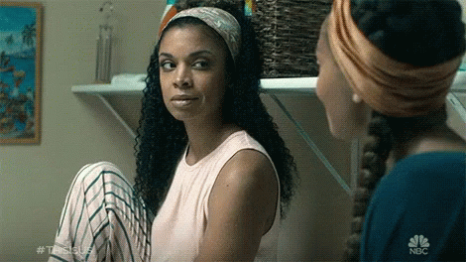
Your Emotions are Contagious
QUESTION:
Have you ever had someone laugh, or smile at you, and you instinctively smiled back, no matter how you were feeling?
WHY DOES THIS HAPPEN?
Mirror neurons in your brain cause you to unconsciously mimic actions around you, like a yawn or a smile. Emotions can also be contagious, like stress, anxiety and joy.
Notes:
INSTRUCTOR: Start this slide by yawning as if you are doing it unintentionally and naturally.
ASK: I have a question for all of you. Have you ever yawned, not because you were tired or sleepy, but because you saw someone else yawn first?
ASK: Why does that happen to us? What does a mirror do?
TELL: It reflects our image, right. Well, we have mirror neurons in your brain cause you to unconsciously mimic actions around you, like a yawn or a smile.
TELL: But, research shows that not only yawns and smiles are contagious but also negative emotions like stress, anxiety, boredom, and positive emotions like joy, confidence and commitment.

Slide 24
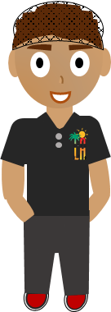
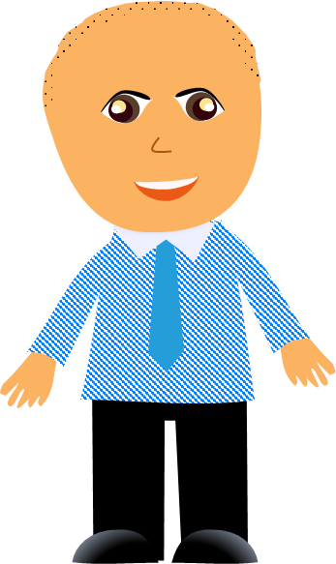
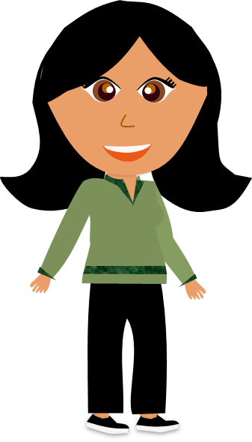
Respect in the Workplace Starts With You
No matter what your role is, you have the choice to create a respectful workplace culture.
Notes:
TELL: Respect in the workplace starts with you. Whether you’re a worker, manager, or a supervisor, you have the choice to create a respectful workplace culture.

